Slide 1
NATs Problem and STUN
107214005 田蕙瑜

Slide 2
NAT Introduction
NAT : Network Address Translation
In RFC 3489, there are 4 types of NAT:
  Full Cone NAT
  Restricted Cone NAT (Address Restricted Cone)
  Port Restricted Cone NAT
  Symmetric NAT
Notes:
要加一張比較表

Slide 3
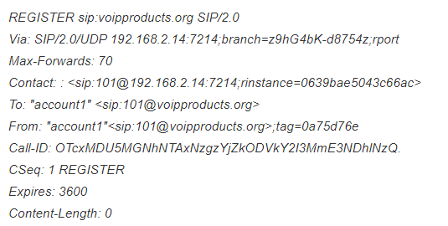
NAT Problem Example
Cannot handle embedded IP addresses or ports
  NAT only translate the TCP/UDP Header
Cannot access internal network services from the public network
SIP Server
163.22.20.108
Registered UAs Table
101@192.168.2.14:7214
NAT
REGISTER : 101@192.168.2.14:7214
UA 101
192.168.2.14
Packet infomation from Reference 6
Notes:
nathelper Module
https://kamailio.org/docs/modules/5.0.x/modules/nathelper.html#idp50918108

Slide 4
NAT Solutions
Client
VPN
  (Virtual Private Network)
STUN
  (Simple Traversal of UDP Through Netwoek Address Translators)
  RFC 3489
  Works except symmetric NAT
TURN
  (Traversal Using Relay NAT)
ICE
  (Interactive Connectivity Establish)
Gateway
ALG
  (Application Layer Gateway)
UPnP
  (Universal Plug-and-Play)
Server
RTP Proxy
Notes:
nathelper Module
https://kamailio.org/docs/modules/5.0.x/modules/nathelper.html#idp50918108

Slide 5
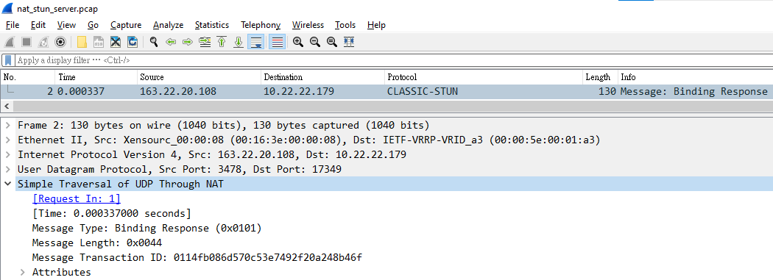
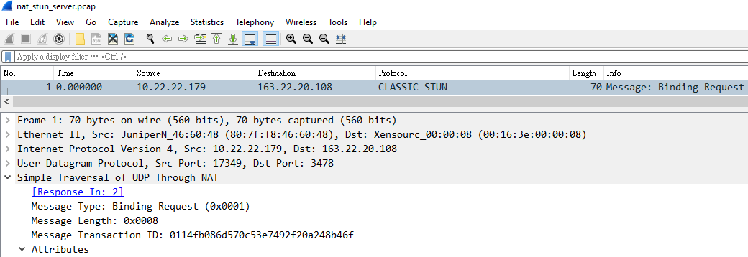
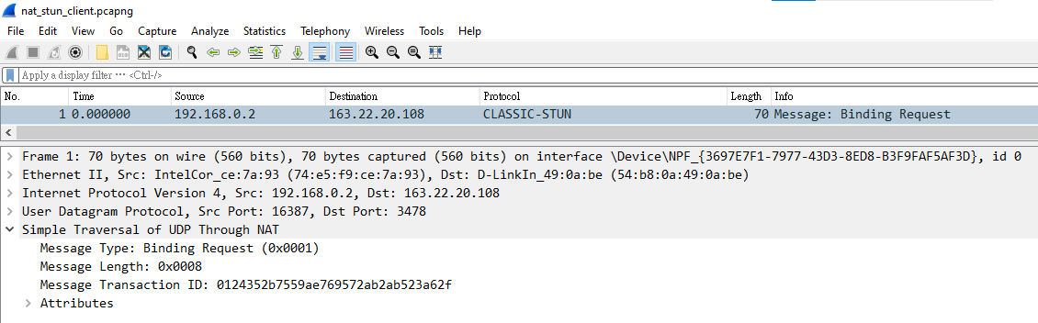
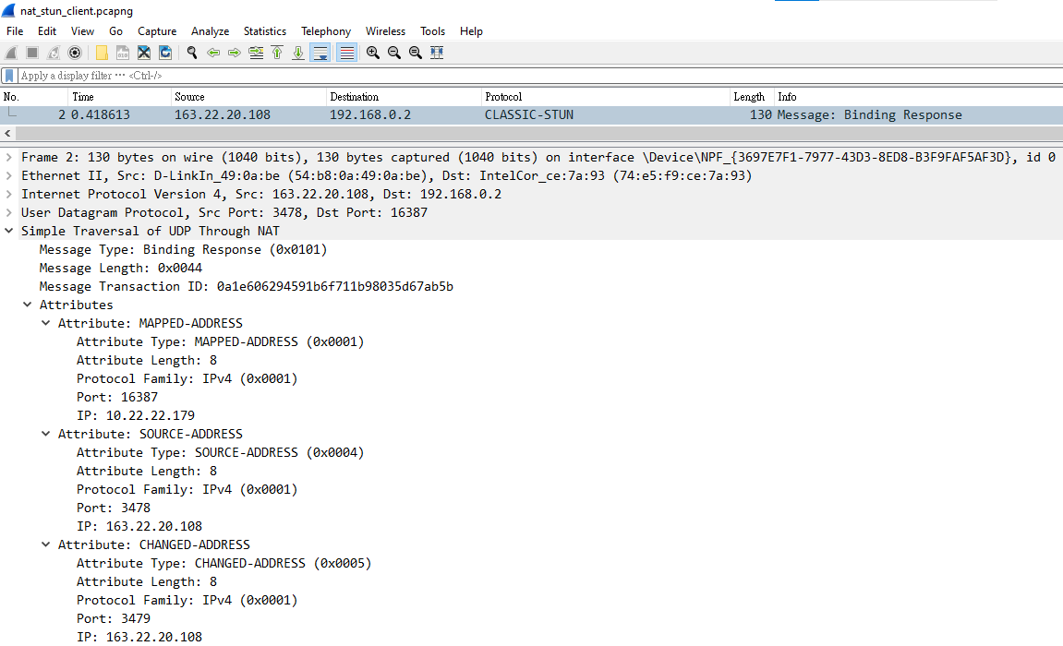
STUN
Client
IP: 192.168.0.2
Port:16387
NAT
IP: 10.22.22.179
Port: 17349
STUN Server
IP: 163.22.20.108
Port: 3478
Mapping Table
192.168.0.2:16387 <-> 17349
( for 163.22.20.108 )
Notes:
Public STUN Server List
https://ourcodeworld.com/articles/read/1536/list-of-free-functional-public-stun-servers-2021
STUN Client Webpage
https://webrtc.github.io/samples/src/content/peerconnection/trickle-ice/

Slide 6
STUN
STUN Binding Reponse will include
  MAPPED-ADDRESS
    STUN Client IP
(after NAT)
  SOURCE-ADDRESS
    STUN Server IP
  CHANGED-ADDRESS
    STUN Server IP

Slide 7
STUN Demo
STUN Server
  Public STUN Server List
    stun.sipnet.net:3478
    stun1.l.google.com:19302
  angela.ncnu.org:3478
STUN Client
  Webpage – Trickle ICE
  Windows Application – WinSTUN

Slide 8

STUN with Symmetric NAT
STUN Server
IP: 163.22.20.108
Port: 3478
Client
IP: 192.168.0.2
Port:16387
Symmetric
NAT
Port: 17349
Kamailio
IP: 163.22.22.67
Port: 5060
Port: 12345
Mapping Table
192.168.0.2:16387 <-> 17349 ( for STUN Server)
192.168.0.2:16387 <-> 12345 ( for SIP Server )
Notes:
Add order

Slide 9
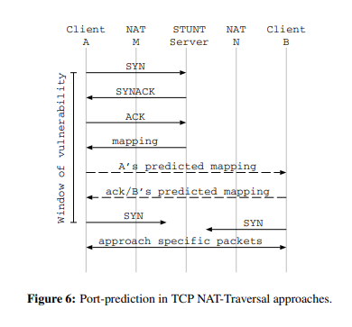
Port Prediction
Port Preserving
  Lots of NATs will allocate a mapped port
  Usaully the difference of new mapped port is fixed
Picture from Reference 2
Notes:
http://www.cs.nccu.edu.tw/~lien/Writing/NGN/firewall.htm

Slide 10
Reference
ROSENBERG, Jonathan, et al. STUN-simple traversal of user datagram protocol (UDP) through network address translators (NATs). 2003.
GUHA, Saikat; FRANCIS, Paul. Characterization and measurement of tcp traversal through nats and firewalls. In: Proceedings of the 5th ACM SIGCOMM Conference on Internet Measurement. 2005. p. 18-18.
GUHA, S., TAKEDA, Y., AND FRANCIS, P. NUTSS: A SIP-based Approach to UDP and TCP Network Connectivity. In Proceedings of SIGCOMM’04 Workshops (Portland, OR, Aug. 2004), pp. 43–48.
Midcom, W.G., 2003. Symmetric NAT Traversal Using STUN, draft-takeda-symmetric-nat-traversal-00. txt. IETF (2003-2006).
穿越防火牆技術
Sending of a SIP message without using STUN protocol
Set up your STUN Server

Slide 11
NAT Problem Example
Cannot handle embedded IP addresses or ports
  NAT only translate the TCP/UDP Header
Cannot access internal network services from the public network
SIP Server
163.22.20.108
Registered UAs Table
Alice@10.22.22.23
Alice@10.22.22.23
Proxy Request (ask Alice)
NAT
UA Bob
163.22.20.24
REGISTER : Alice@10.22.22.23
UA Alice
10.22.22.23
Packet infomation from Reference 6
Notes:
nathelper Module
https://kamailio.org/docs/modules/5.0.x/modules/nathelper.html#idp50918108

Slide 12
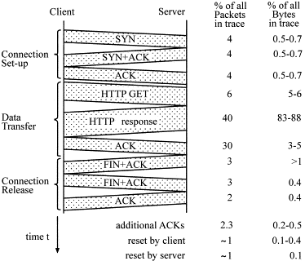
NAT Solutions
STUN(Simple Traversal of UDP Through Netwoek Address Translators) - RFC 3489
TRUN(Traversal Using Relay NAT)
ALG(Application Layer Gatewqy)
ICE(Interactive Connectivity Establish)
Notes:
picturn from
https://www.sciencedirect.com/science/article/abs/pii/S0166531600000286

Slide 13
NAT Problem
Cannot handle embedded IP addresses or ports
  NAT only translate the TCP/UDP Header
  NAT cannot translate IP address or port information embedded in the application data
Cannot access internal network services from the public network
Notes:
nathelper Module
https://kamailio.org/docs/modules/5.0.x/modules/nathelper.html#idp50918108

